Slide 1

Modeling Pedestrian Flow in a Crowded Building
GESS Course
Complex Social Systems: Modeling Agents, Learning, and Games
Battista, Biella, Ferradini, Fioroni, Guillement

Slide 2
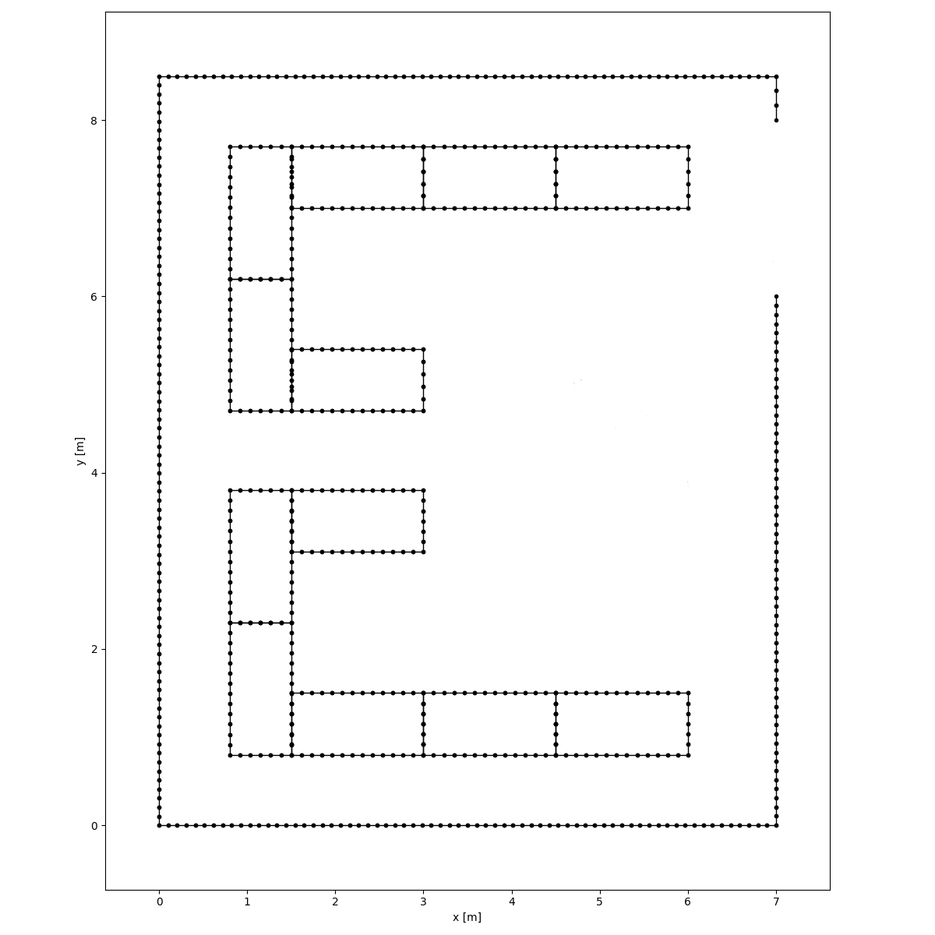

Aim
Microscopic simulation of pedestrian motion
Test the simulation against some simple environment configurations
Apply the simulation to a classroom

Slide 3

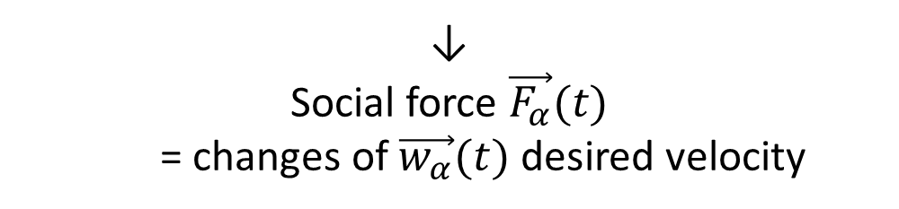
The Social Force Model
Agents $α$ that react to information from the environment
↓
Social force $\vec{F_{α}}(t)$
= changes of $\vec{w_{α}}(t)$ desired velocity

Slide 4





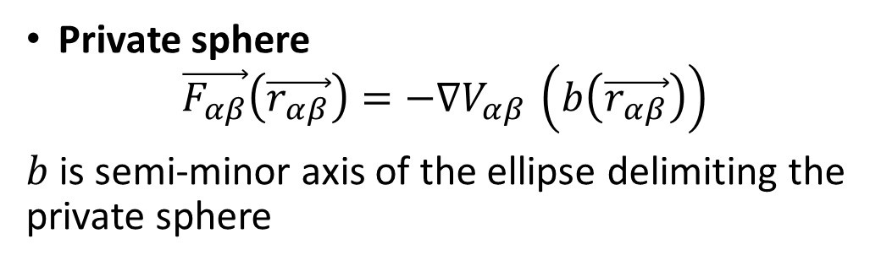
The Force:
Goal $\vec{r_{α}^{0}}$ and ’’least action principle’’
$$\vec{e_{α}}\left(t\right)=\frac{\vec{r_{α}^{k}}−\vec{ r_{α} }\left(t\right)}{\vec{||r_{α}^{k}}−\vec{ r_{α} }\left(t\right)||}$$
=> desired velocity $\vec{v_{α}^{0}}(t)=v_{α}^{0}\vec{ e_{α}}\left(t\right)$
=> $\vec{F_{α}^{0}}\left(t\right)=\frac{\vec{v_{α}}\left(t\right)−\vec{v_{α}^{0}}\left(t\right)}{τ_{α}}$
Private sphere
$$\vec{F_{αβ}}\left(\vec{r_{αβ}}\right)=−∇V_{αβ }\left(b\left(\vec{r_{αβ}}\right)\right)$$
$b$ is semi-minor axis of the ellipse delimiting the private sphere
Border effects
$$\vec{F_{αB}}\left(\vec{r_{αB}}\right)=−∇U_{αB }(\vec{r_{αB}})$$

Slide 5

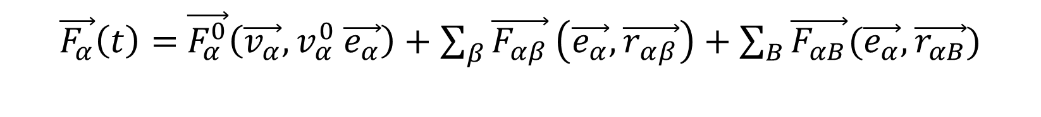
Resultant force:
All these effects are independent:
$\vec{F_{α}}\left(t\right)=$ $\vec{F_{α}^{0}}\left(\vec{v_{α}}, v_{α}^{0} \vec{e_{α}}\right)+\sum_{β}{\vec{F_{αβ}}}\left(\vec{e_{α}}, \vec{r_{αβ}}\right)+\sum_{B}{\vec{F_{αB}}(\vec{e_{α}}, \vec{r_{αB}})}$
$$+fluctuations$$

Slide 6
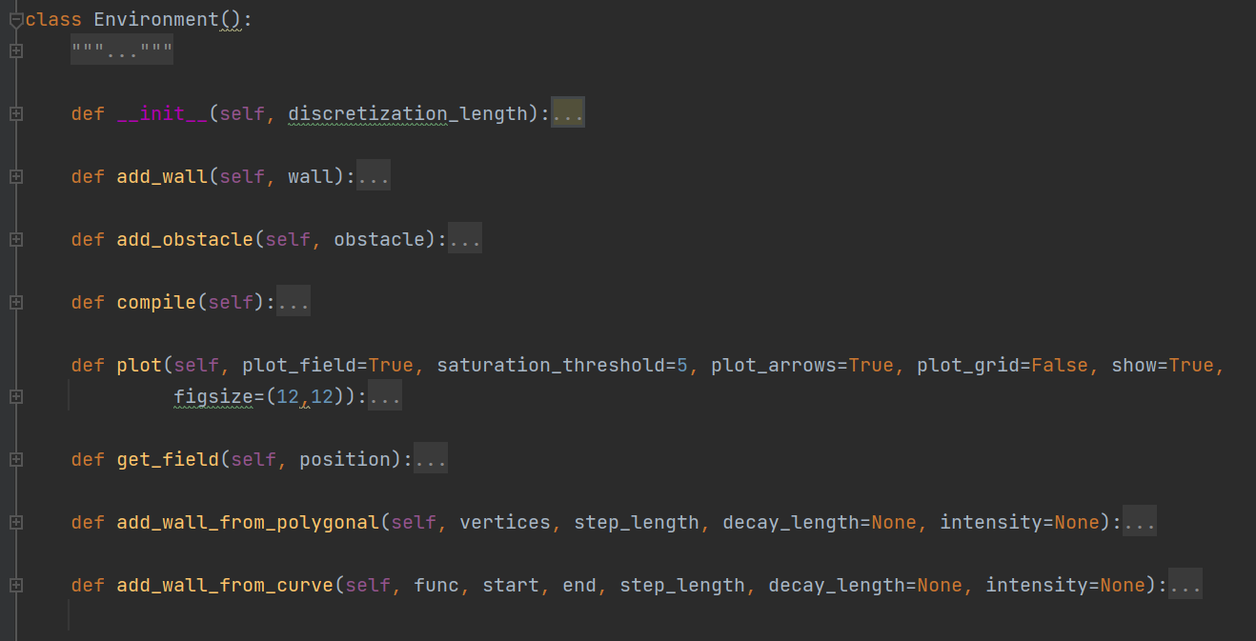
Environment

Slide 7
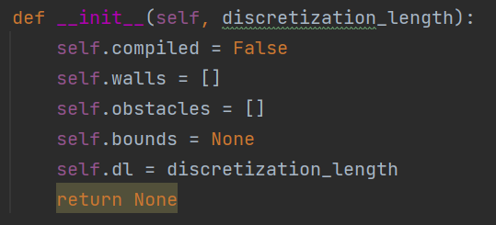

Slide 8
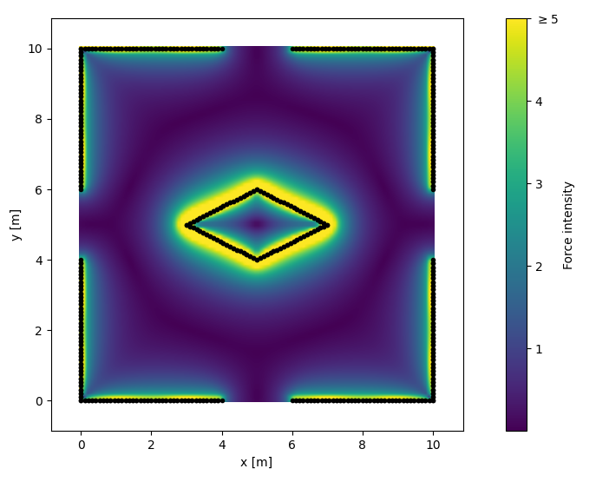
Discretized force field in a 10x10 m. room with a central wedge.

Slide 9

Agents

Slide 10
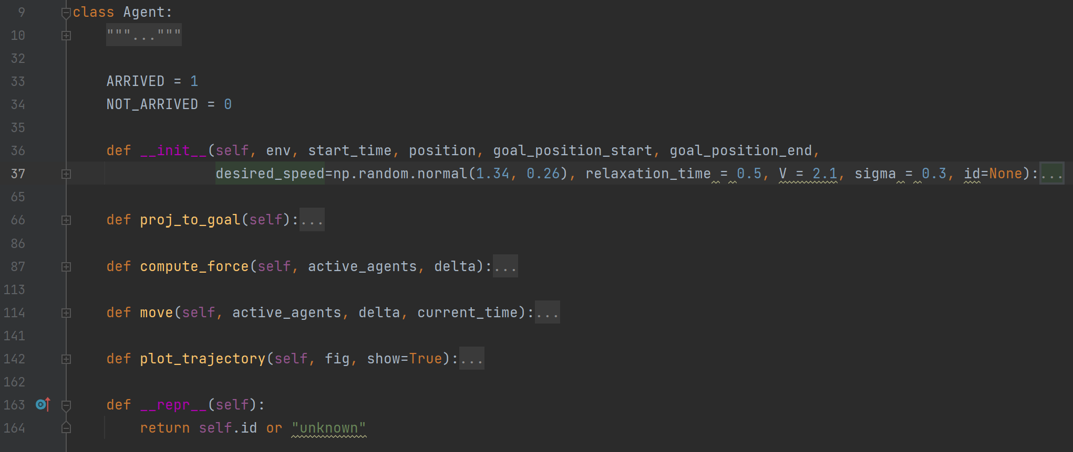

Slide 11
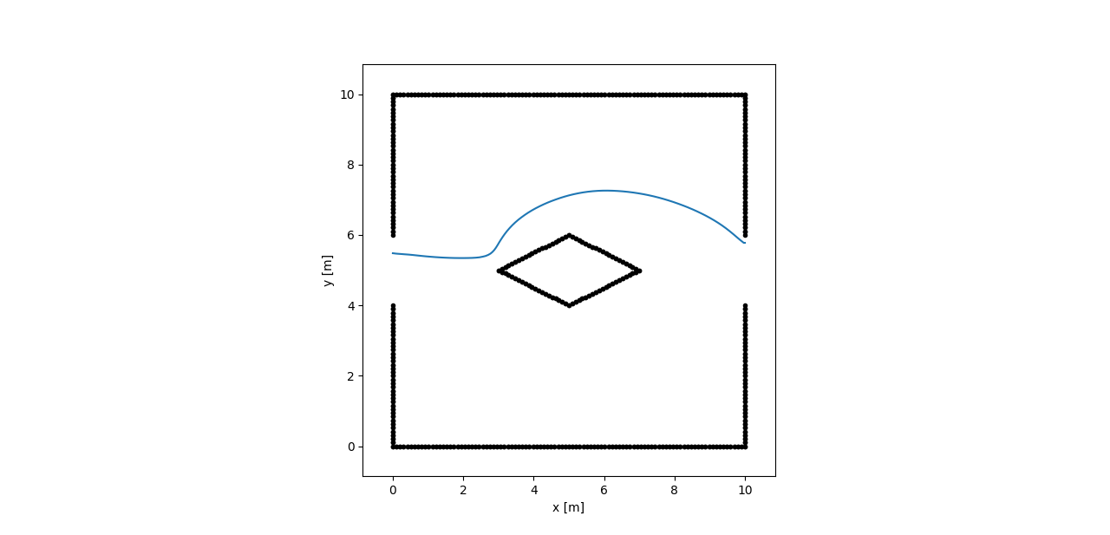
Trajectory of an agent in a 10x10 m. room with a central wedge.

Slide 12
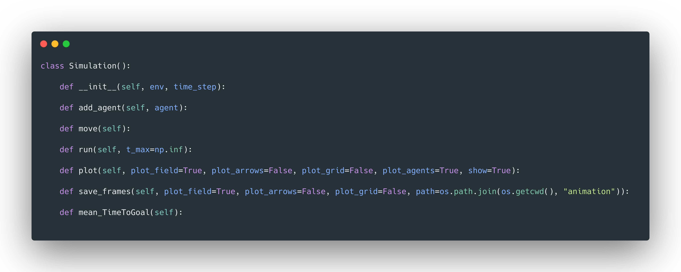
Simulation

Slide 14
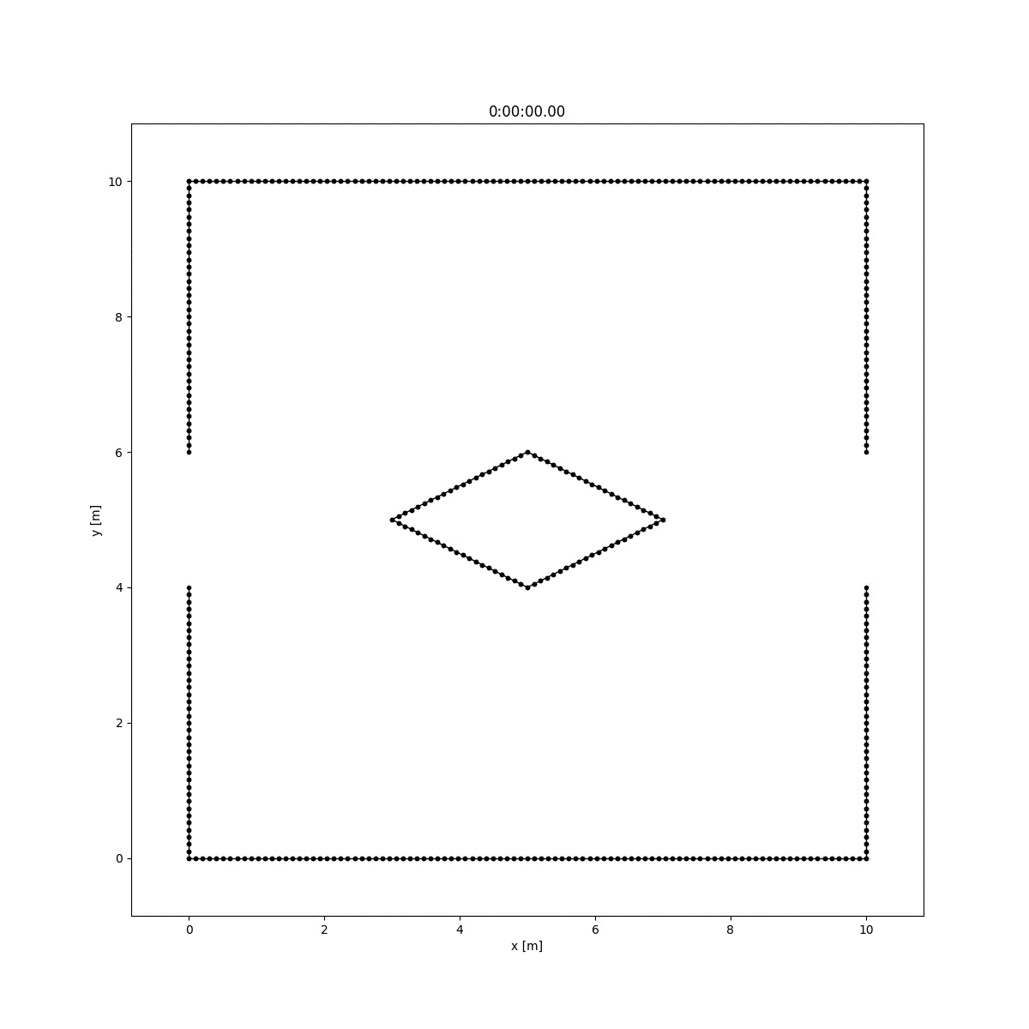
Simulation
10x10 m room
2 doors
Central wedge
50 agents

Slide 15
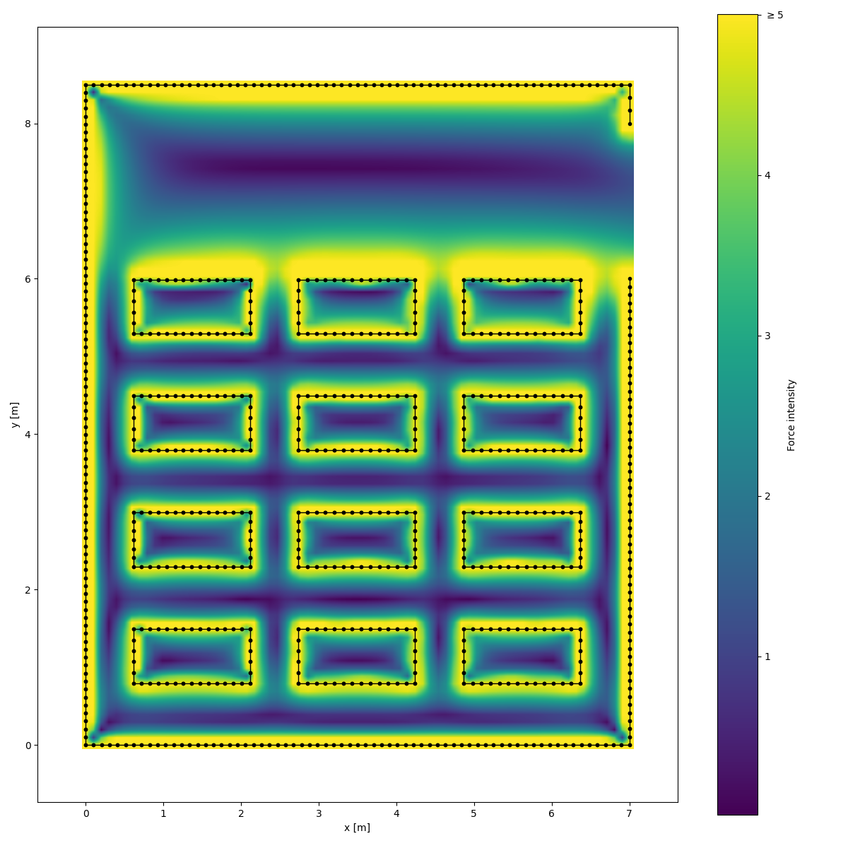
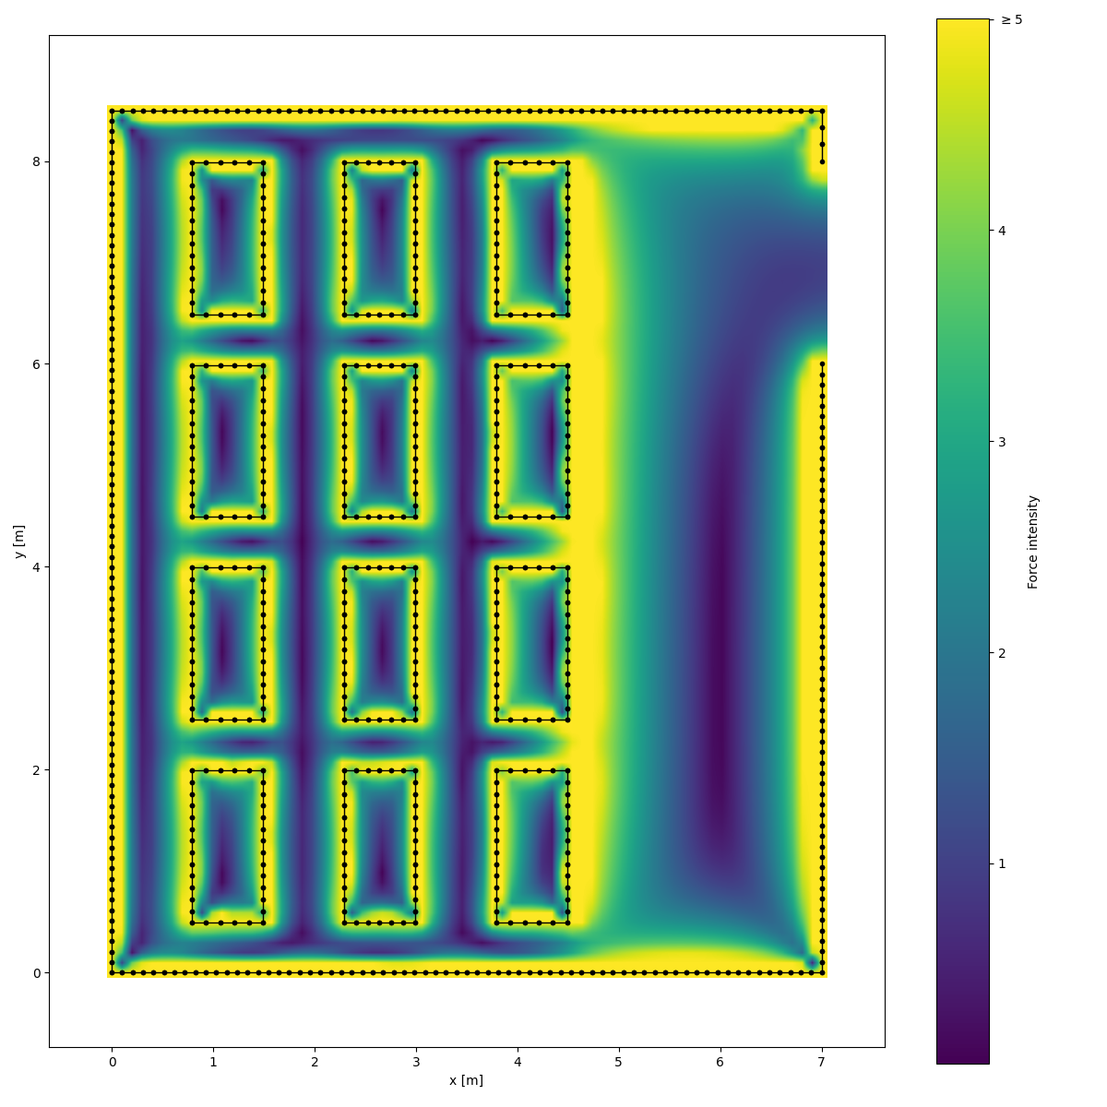
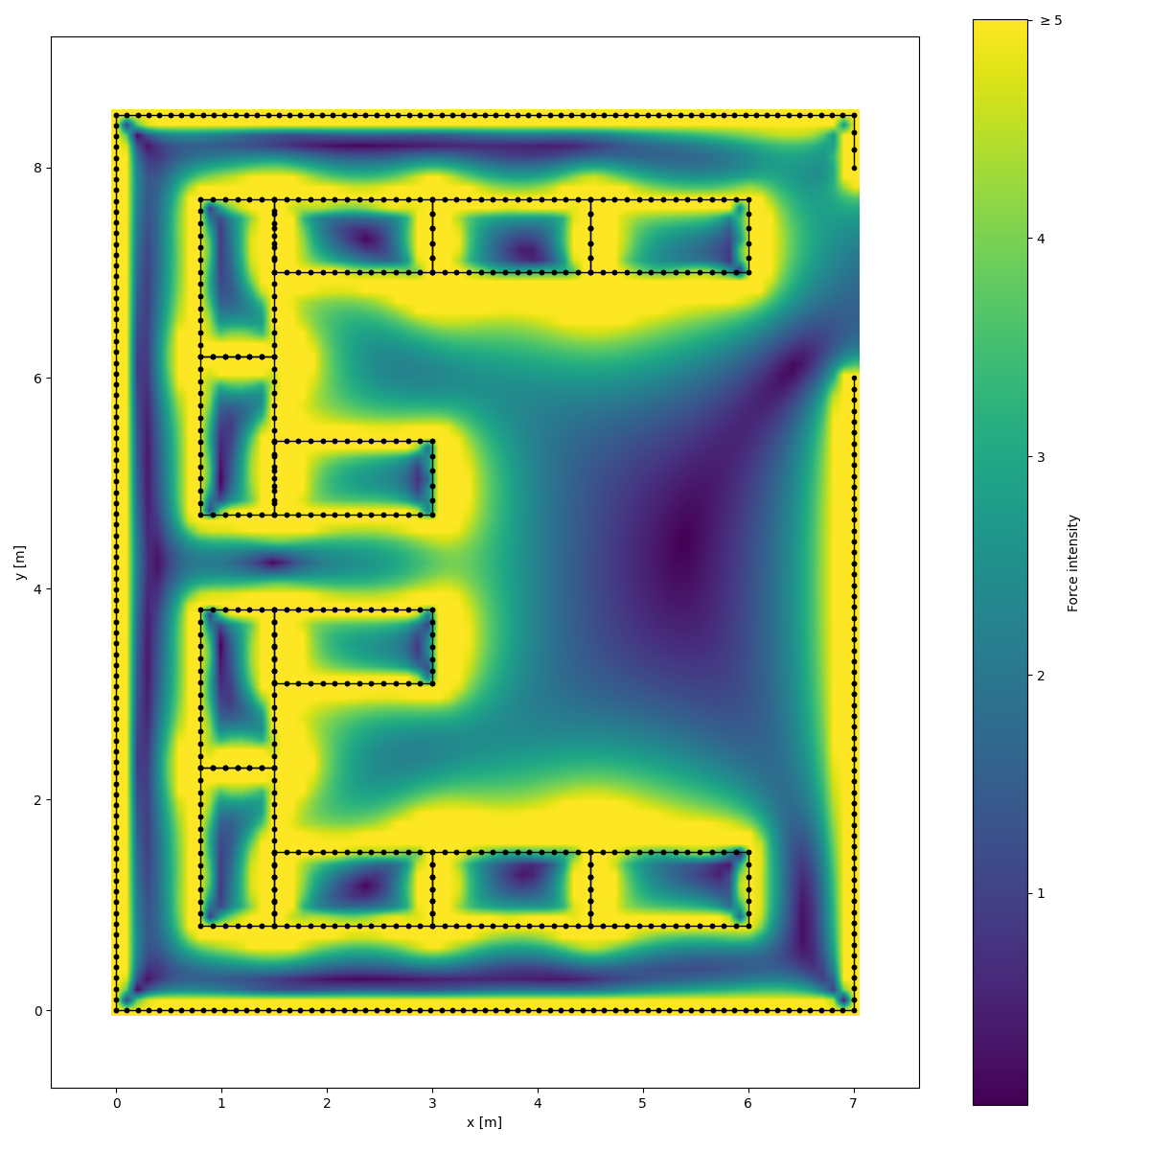
Example: Classroom

Slide 16
Example: Classroom
Configuration | <t> [s] | σ [s]
Short Side | 10.58 | 0.04
Long Side | 12.4 | 0.2
U-Shape | 8.5 | 0.1

Slide 17
Problems & Difficulties

Slide 18
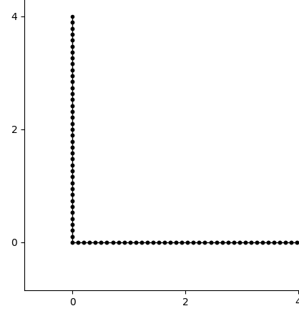
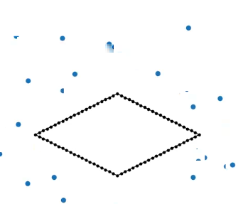
Problems & Difficulties
Realistic Behaviour
Discretization of Walls
Third Party Software
Notes:
Given a point in space, in order to compute the field in that point one should in principle integrate the force given by each infinitesimal length of wall dx. In order to avoid that, we divided each wall in segments and computed the force relative to each of the segments.

Slide 19
Evaluation

Slide 20
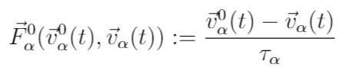
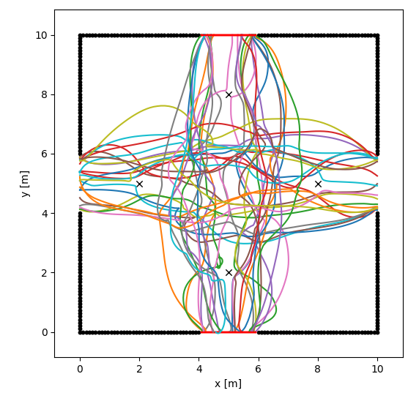
Evaluation
Interesting Theory
Desired Output
Coherent Example
New Ideas

Slide 21

Questions?

